Slide 1
Implementing Variational Quantum Algorithms as Compositions of Reusable Microservice-based Plugins
Matthias Weilinger
st156232@stud.uni-stuttgart.de

Slide 2
Contents of the Presentation
Background on Variational Quantum Algorithms (VQAs)
Problem Statement
Architecture
Result Validation
Interchangeability
Performance Benchmarks
Conclusion
Outlook

Slide 3
Background

Slide 4

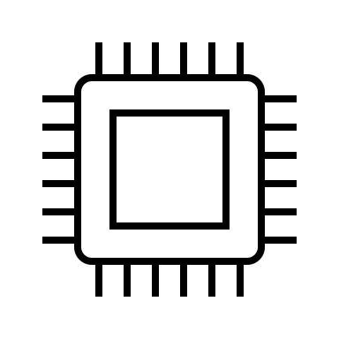

What is a VQA?
Update parameters
Training Data
Initial Weights
Objective Function
Optimizer
Loss
Minimized
Weights
Return loss
Hybrid Loop

Slide 5
Problem Statement
Design and implement modular framework in QHana
Implement components of optimization process as distinct plugins
Allow for interactions between plugins
Objectives
Decompose optimisation process into plugins
Implement robust communication mechanism
Coordinate plugins to solve optimization process

Slide 6
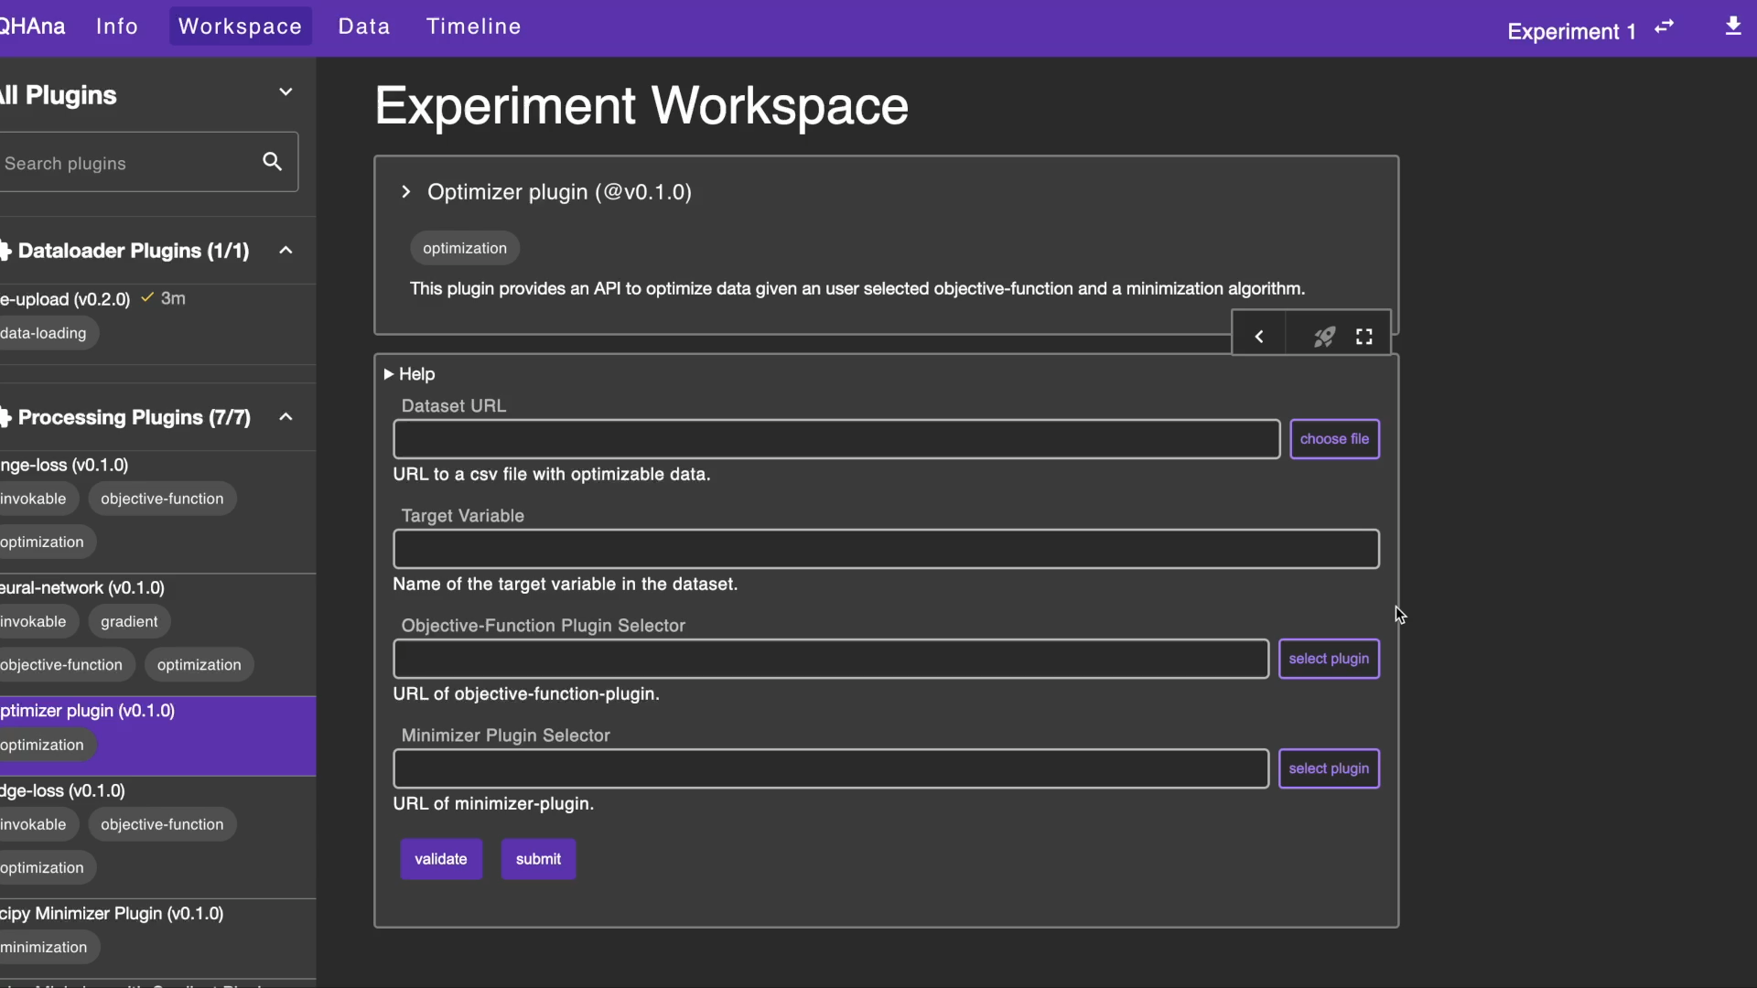
QHana Demo

Slide 7
Architecture

Slide 8

Architecture - Decomposition
Minimizer Plugin
get metadata
get UI
minimize
results
input
metadata
results
UI
Coordinator Plugin
get
loss/gradient
loss/gradient
get metadata
get UI
training data
metadata
UI
# weights
Objective Function Plugin

Slide 9
Architecture - Challenges
Implementation any form of plugin interactions
Short-running interactions (e.g., retrieve metadata)
Long-running interaction (e.g., do minimization)
Plugin invoking another plugin’s frontend
Standardized endpoints to allow for interchangeability
Keeping context between endpoints
Efficient data formats
…

Slide 10

Architecture - 2 Resulting Approaches
Key difference: Objective Function Plugin holds (no) state
Decoupled approach
Integrated approach
OF user input
Coordinator Plugin
session-ID
Objective Function Plugin
hyperparameter1,
hyperparameter2,
…
hyperparameter1,
hyperparameter2,
…
DB

Slide 11
Architecture - 2 Resulting Approaches
Key difference: Objective Function Plugin holds (no) state
Decoupled approach
Integrated approach
Pass Data
Coordinator Plugin
training data
Objective Function Plugin
training data
hyperparameter1,
hyperparameter2,
…
hyperparameter1,
hyperparameter2,
…
training data
DB

Slide 12
Architecture - 2 Resulting Approaches
Key difference: Objective Function Plugin holds (no) state
Decoupled approach
Integrated approach
Minimization
Coordinator Plugin
Objective Function Plugin
weights
training data
hyperparameter1,
hyperparameter2,
…
training data
hyperparameter1,
hyperparameter2,
…
loss URL
training data
hyperparameter1,
hyperparameter2,
…
loss URL
weights
Minimizer Plugin
DB

Slide 13
Result Validation

Slide 14
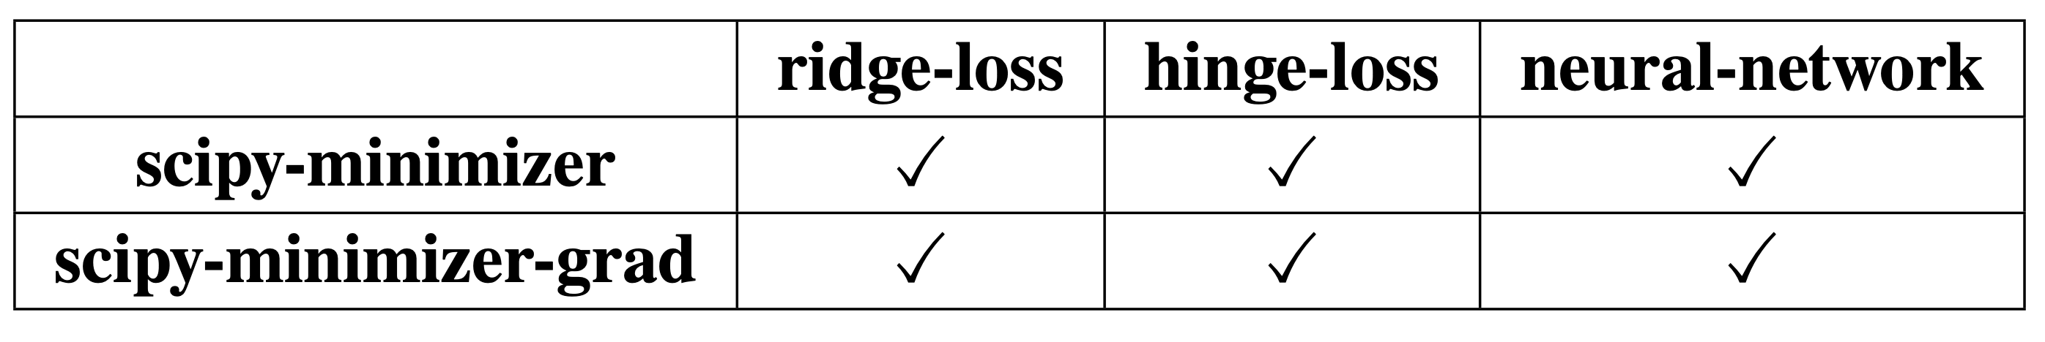
Interchangeability Results
Implemented different plugins with different functionalities
All plugins adhere to the proposed standards without a problem
Standards are designed to allow for interchangeability
New plugins can adhere to the standards
New plugins are interchangeable as well

Slide 15
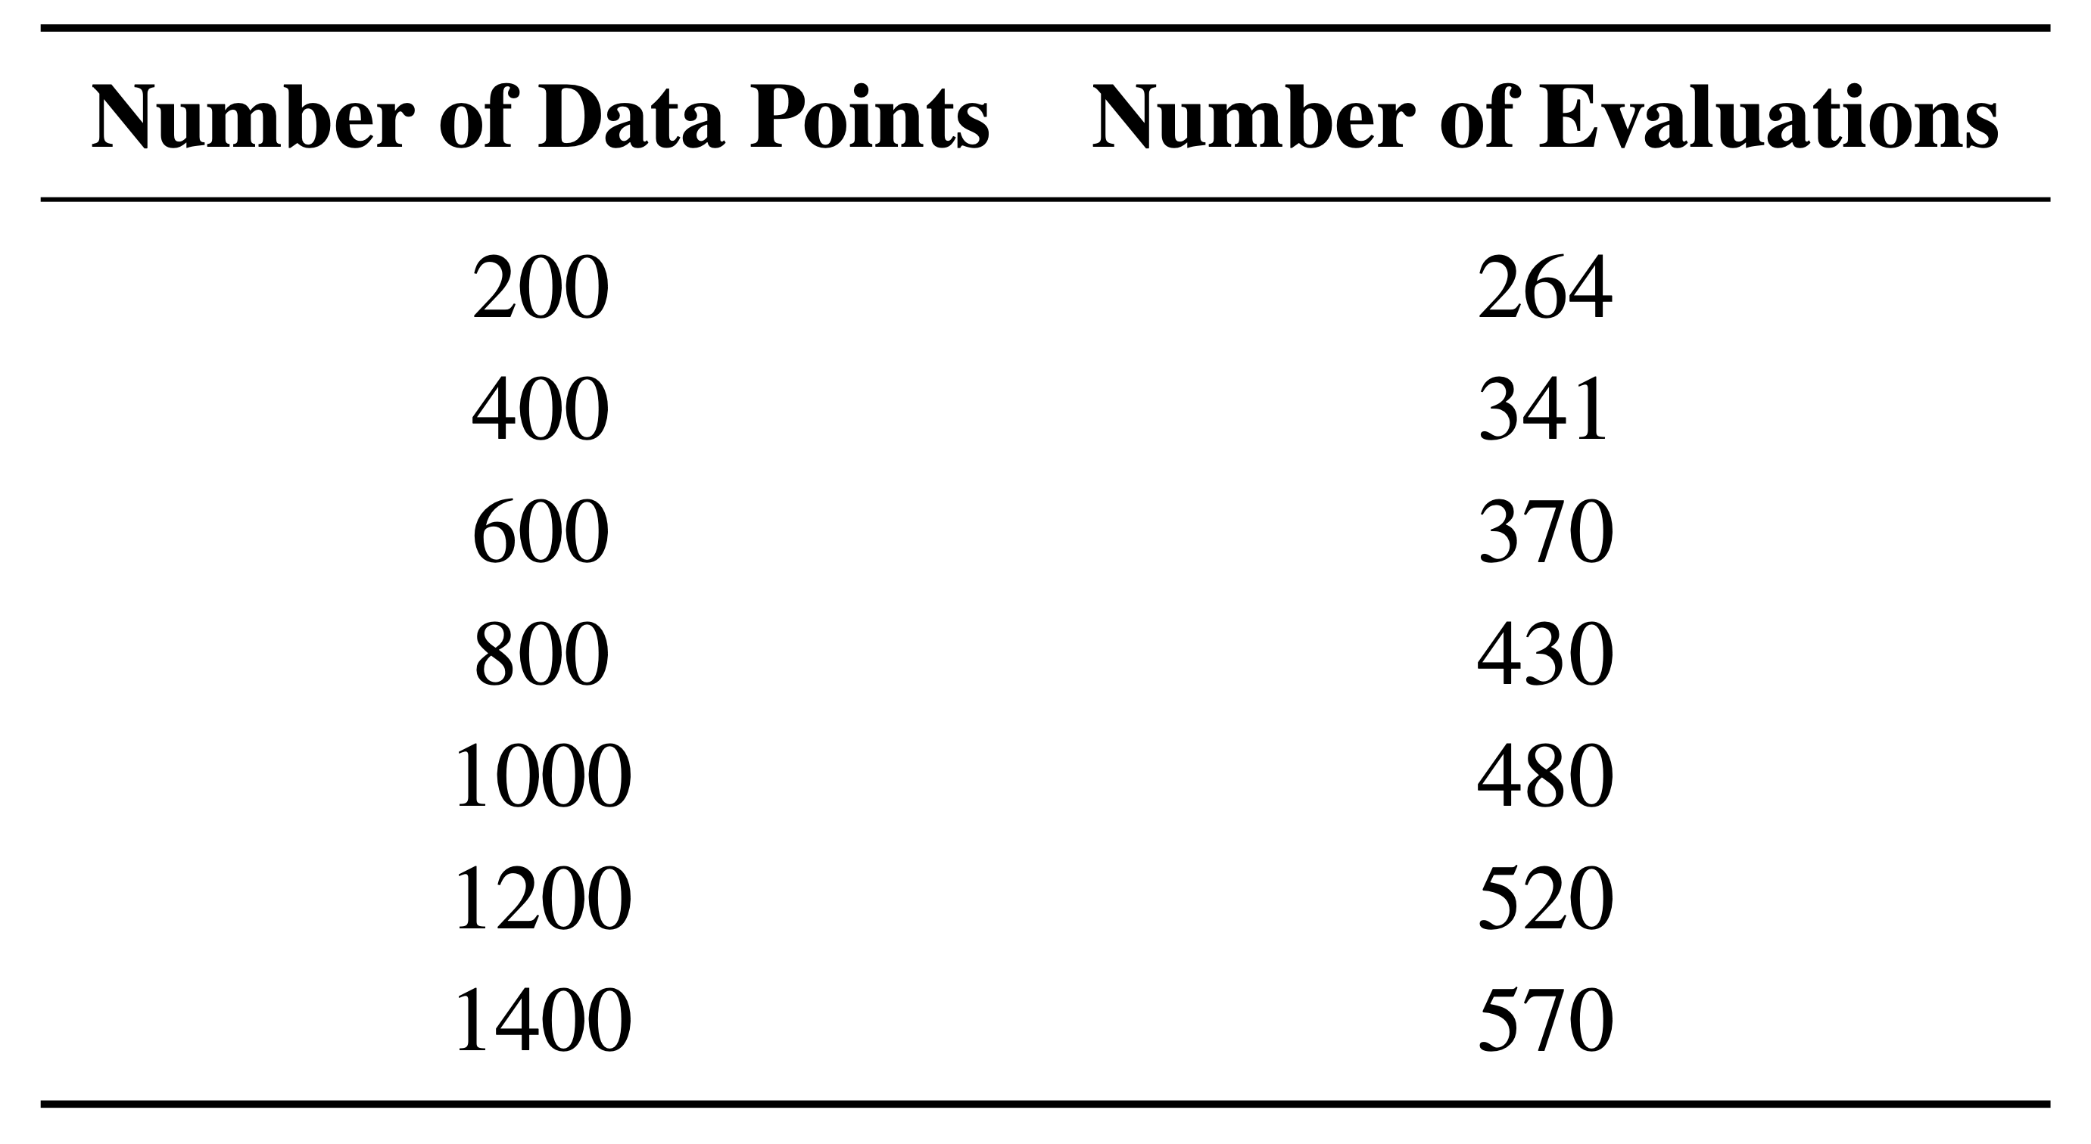
Performance Benchmarks
Compare 2 plugin-based implementatin appraoches
Jupyter Notebook implementation as ground truth comparison
Use different datasets with increasing number of data points and feature
Use ridge-loss and scipy plugins
Objective Function evaluation is main contributor to performance

Slide 16
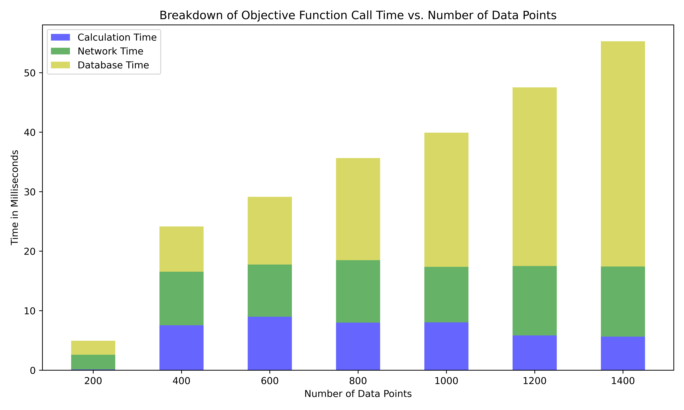
Performance Benchmarks
Time it takes for a single call to the calc_loss endpoint of the ridge-loss plugin for
different dataset sizes for the decoupled plugin-based implementation approach.

Slide 17
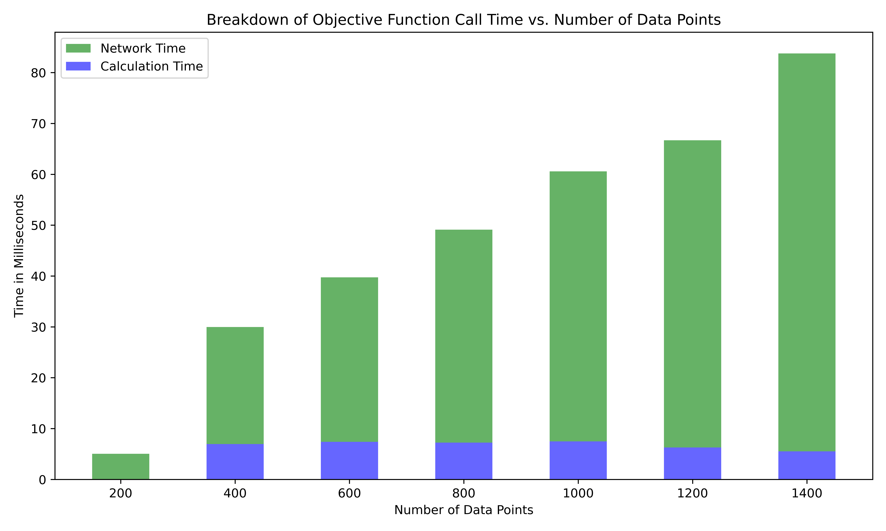
Performance Benchmarks
Time it takes for a single call to the calc_loss endpoint of the ridge-loss plugin for
different dataset sizes for the integrated plugin-based implementation approach.

Slide 18
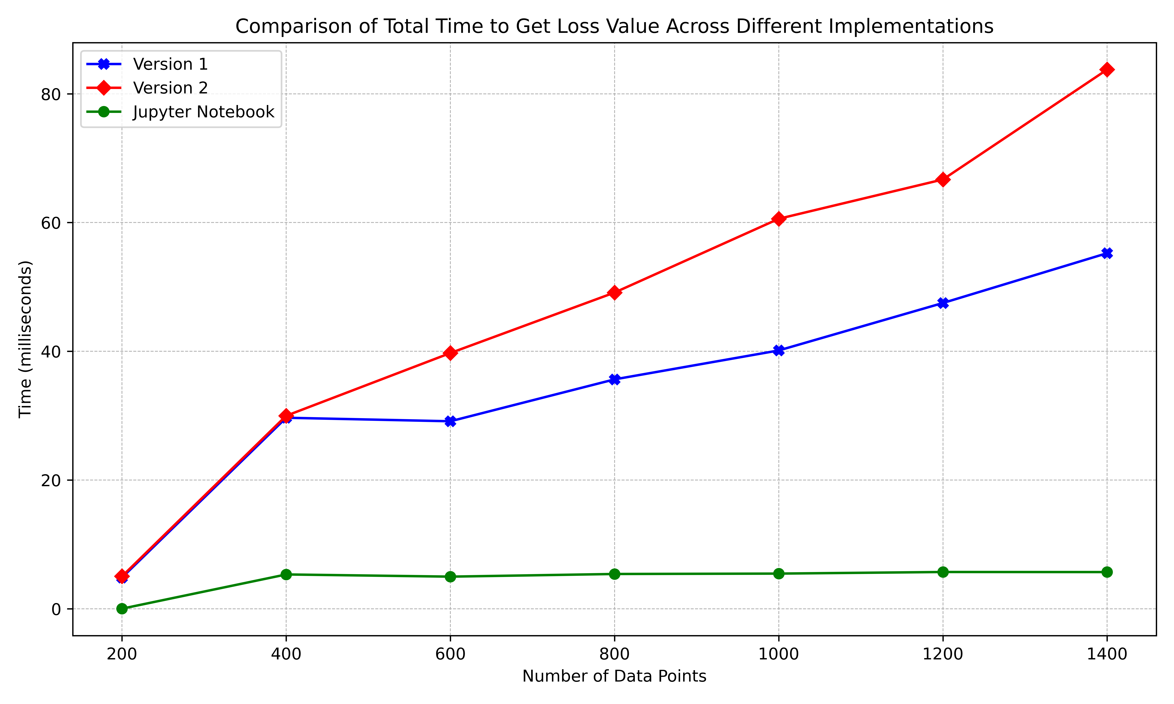
Performance Benchmarks
Comparison of the total time it takes to get the loss value across different implementations, including the Jupyter Notebook implementation.

Slide 19
Problem: Overhead
Significant database and network latencies
Can not decrease network latency
Decoupled approach sends minimal data already
Integrated approach needs all the data on every call
Cache database lookups in decoupled approach (version 1)
Input and target data and hyperparameters do not change during minimization
Flask-Caching adds caching support for constant data
Only single call to database nescasarry, then data will stay in memory

Slide 20
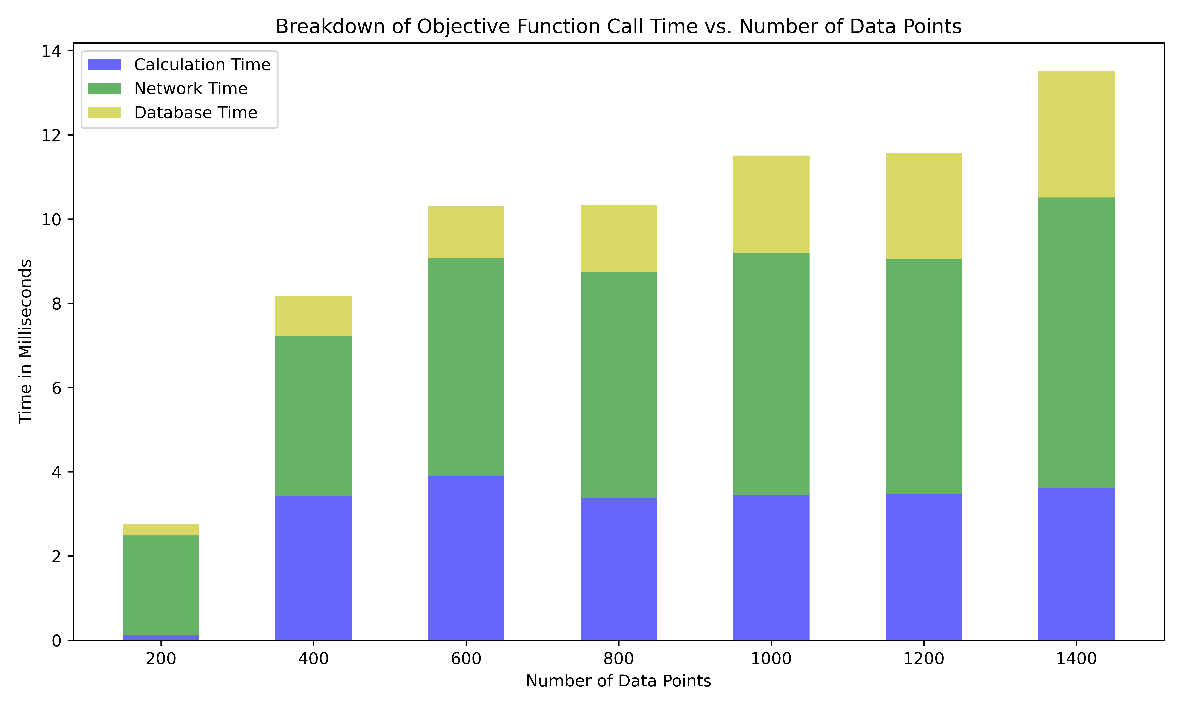
Performance Benchmarks witch Caching
Time it takes for a single call to the calc_loss endpoint of the ridge-loss plugin for
different dataset sizes with caching.

Slide 21
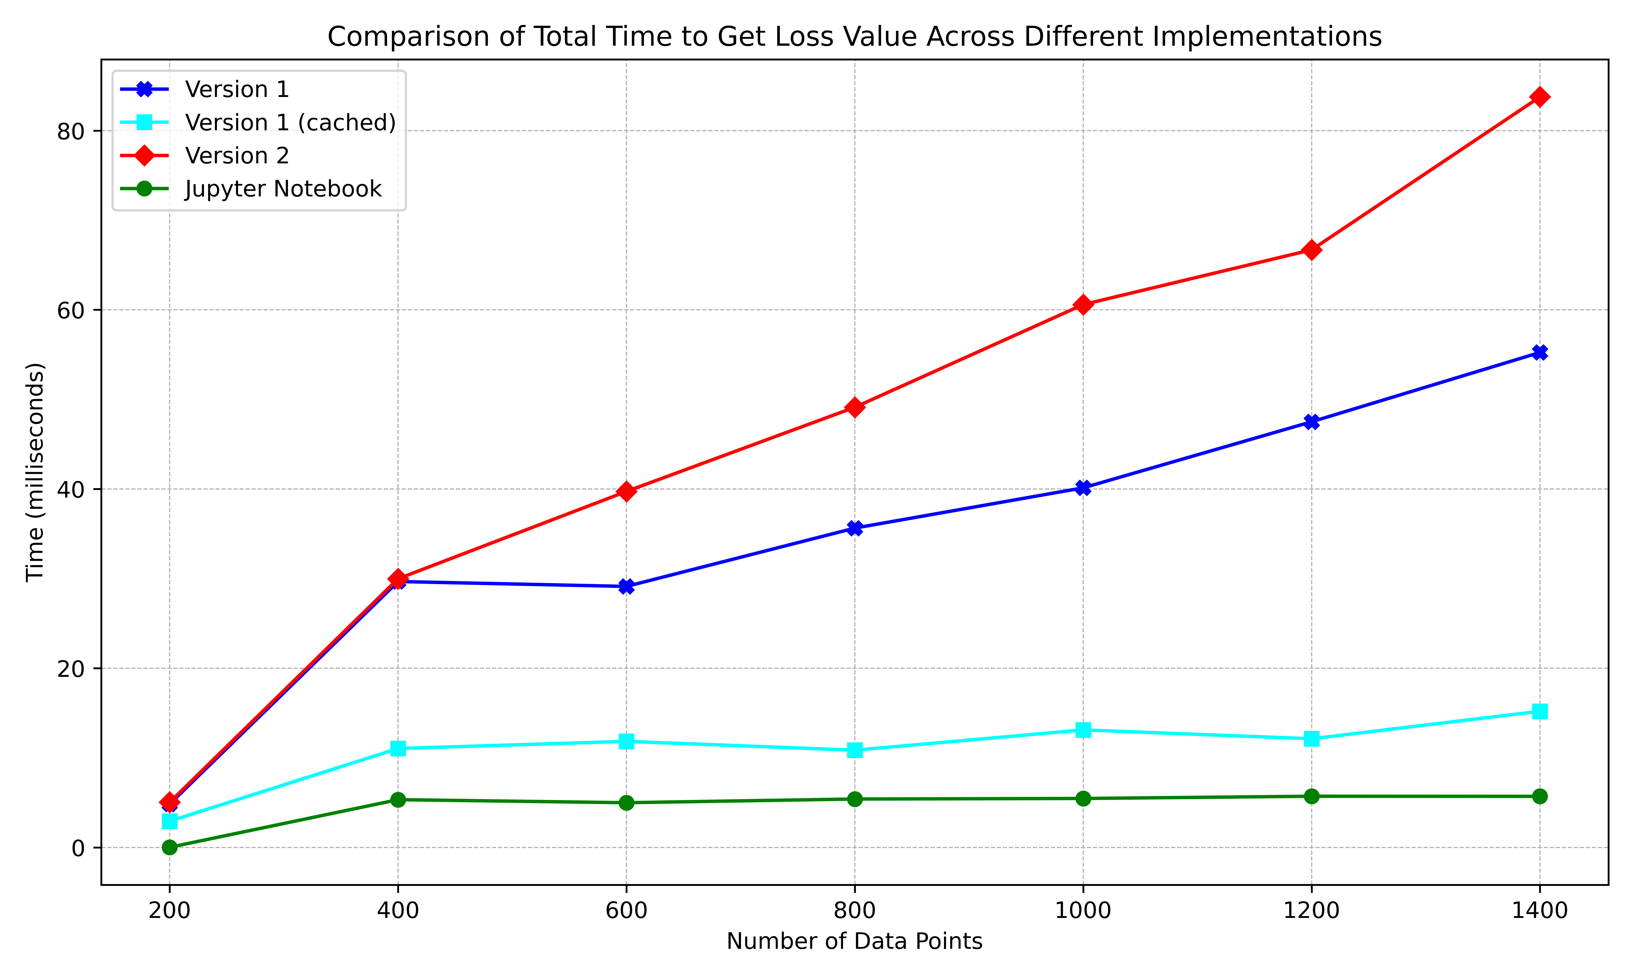
Performance Benchmarks with Caching
Comparison of the total time it takes to get the loss value across different implementations, including a cached version of the first plugin-based implementation approach.

Slide 22
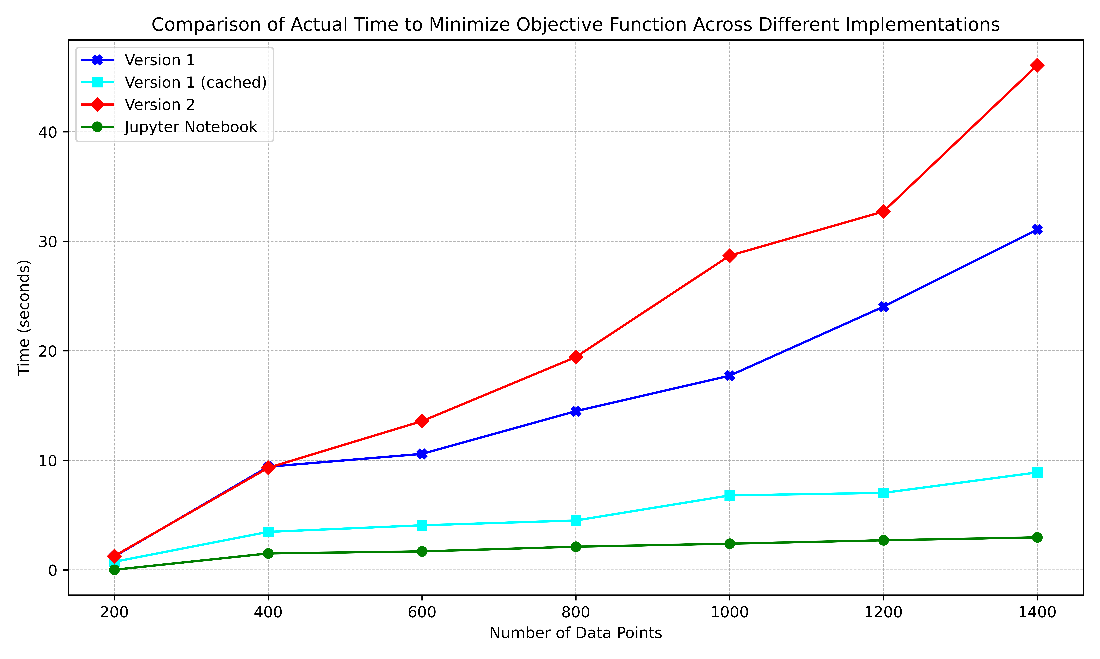
Performance Benchmarks with Caching
Comparison of the total time it takes to complete the minimization process across
different implementations.

Slide 23
Performance Bencharks Conclusion
Compared 3 plugin-based approaches and a Jupyter Notebook implementation
Significant database and network latencies without caching
Network latency can not be further reduced
Decoupled approach with caching shows competetive performance
In context of VQAs the latencies deminish because loss calucation times are orders of magnitude greater

Slide 24
Conclusion and Outlook

Slide 25
Conclusion and Outlook
Implemented modular framework for optimization in QHana
Sound plugin decomposition
Robust communication mechanism
Allows for future contribution of new plugins for optimization
Achieves competetive performance
Communication mechanism can be used for any plugin interaction

Slide 26
Thank you for listening. Any Questions?

